Slide 1
Uninformed/Blind Search
BBM 405 – Fundamentals of Artificial Intelligence
Pinar Duygulu
Hacettepe University
Slides are mostly adapted from AIMA, MIT Open Courseware,
Manuela Veloso(CMU) and
Svetlana Lazebnik (UIUC)
CS461 Artificial Intelligence © Pinar Duygulu
Spring 2008

Slide 2
Uninformed search strategies
A search strategy is defined by picking the order of node expansion
Uninformed search (blind search) strategies use only the information available in the problem definition
Can only distinguish goal states from non-goal state
Breadth-first search
Uniform-cost search
Depth-first search
Depth-limited search
Iterative deepening search
CS461 Artificial Intelligence © Pinar Duygulu
Spring 2008
Notes:
Last time we have seen how to define a problem. Then we discussed some methods to find a solution by searching through the state space.
The methods are distinguished by the search strategy they use.
First we will discuss the uninformed search or the so called blind search strategies.
The term comes from the fact that they have no information about the number of steps or the path cost from the current state to the goal.
They can only distinguish a goal state from a non-goal state.
In this lecture we will discuss a group of uninformed search strategies and will evaluate them through using four criteria.

Slide 3
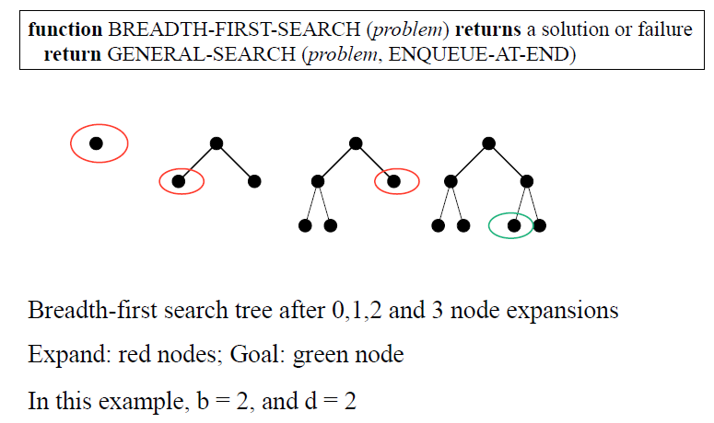

Breadth First Search
Notes:
Breadth first strategy is the first method that we discuss as an uninformed search strategy.
The root node is expanded first,
Then all the nodes generated by the root are expanded next
And then their successors and so on
It means that it consideres all the paths at length 1 first, then all the nodes at lenth two, and so on

Slide 4
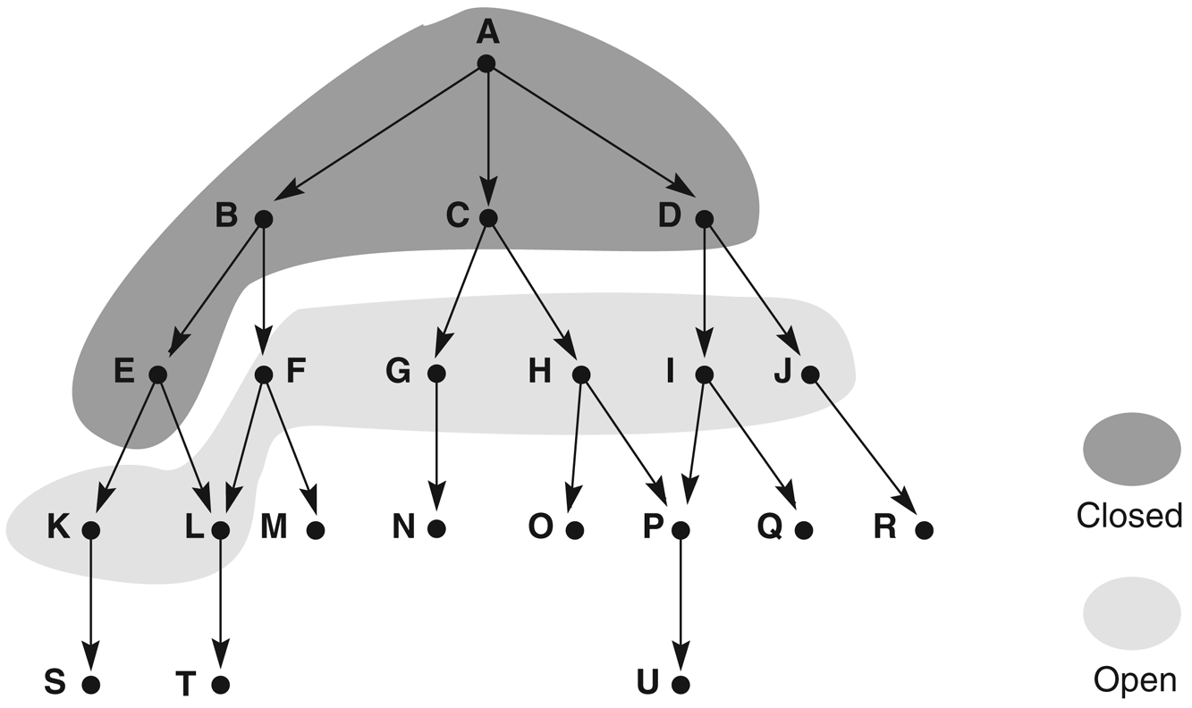
Breadth-first search
CS461 Artificial Intelligence © Pinar Duygulu
Spring 2008
Notes:
Therefore all the nodes at depth d are expanded before the nodes at depth d+1

Slide 5
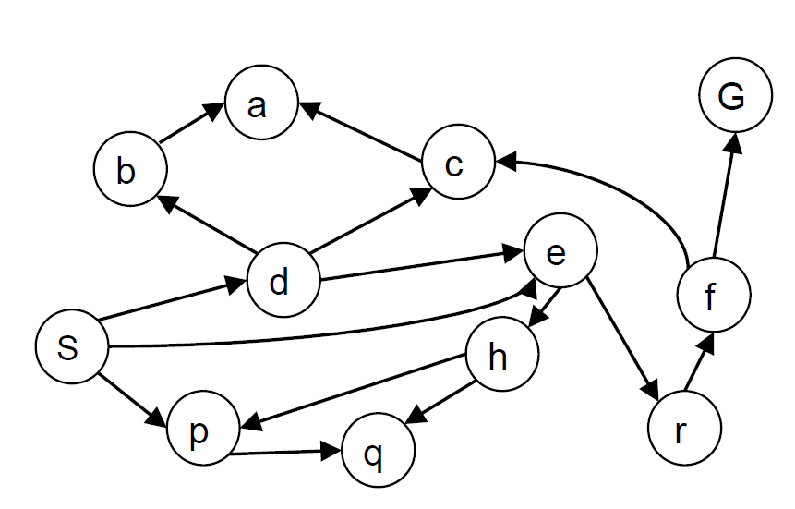
Breadth-first search
Expand shallowest unexpanded node
Implementation: frontier is a FIFO queue
Example state space graph for a tiny search problem
Example from P. Abbeel and D. Klein
Notes:
We can implement breadth first search by using a First in First Out queue.
It means that the newly generated states are put to the end of the queue, after all the previously generated states

Slide 6
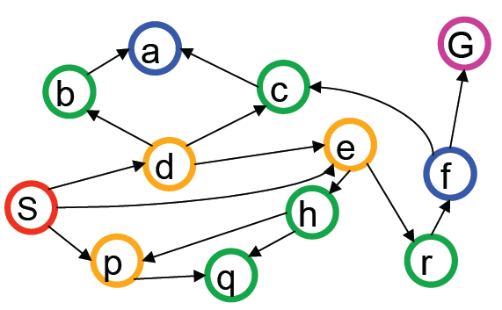
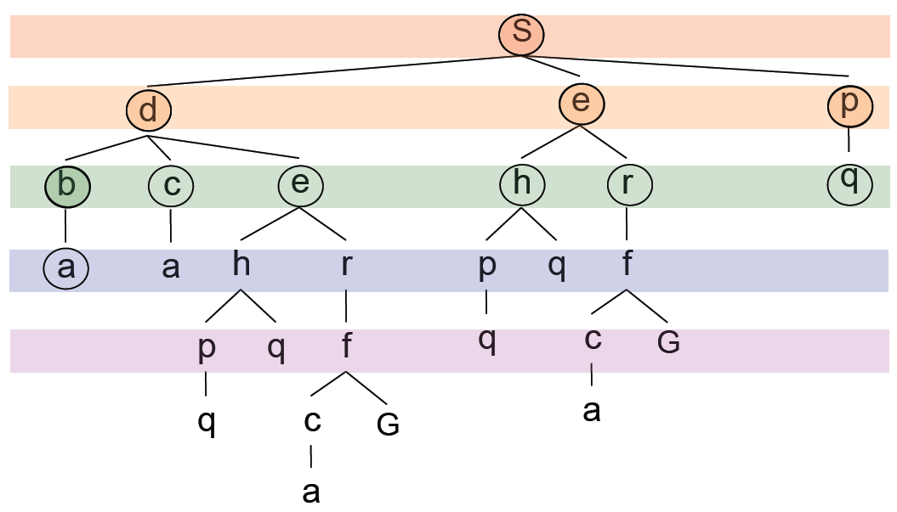
Breadth-first search
Expansion order: (S,d,e,p,b,c,e,h,r,q,a,a, h,r,p,q,f,p,q,f,q,c,G)
Notes:
If we consider this example with G being the goal state
S is expanded first, then we expand its children d e and p which are shown in orange
We continue by expanding the grandchildren b c and e from d. h and r from e, and q from p which are shown in green
From b and c we can reach a which is a dead end
From e we can reach h and r again.
From h to p and q and so on
As you see we reached to G on the 4th level first which is shown in purple
Although we can reach G through S d e r f G path in the next level, we were able to find a shorter path through S e r f G
By expanding all the nodes at level 4 before expanding the nodes at level 5
Note here that G was the 23rd node that we expanded.
And we assume to reach G only when we expand it, not when we put it into the queue

Slide 7
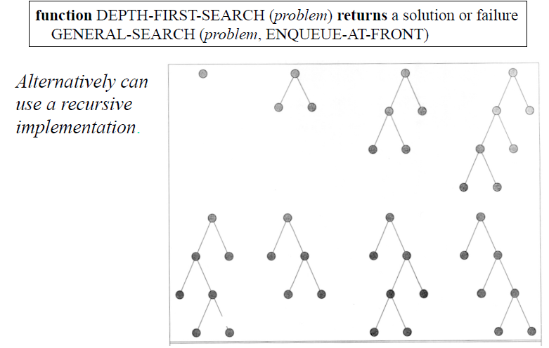
Notes:
The other alternative is to use depth first search which always expands one of the nodes at the deepest level of the tree
Only when the search hits a dead end (it means that a non-goal node with no expansion) the search goes back and expands nodes at shallower levels.

Slide 8
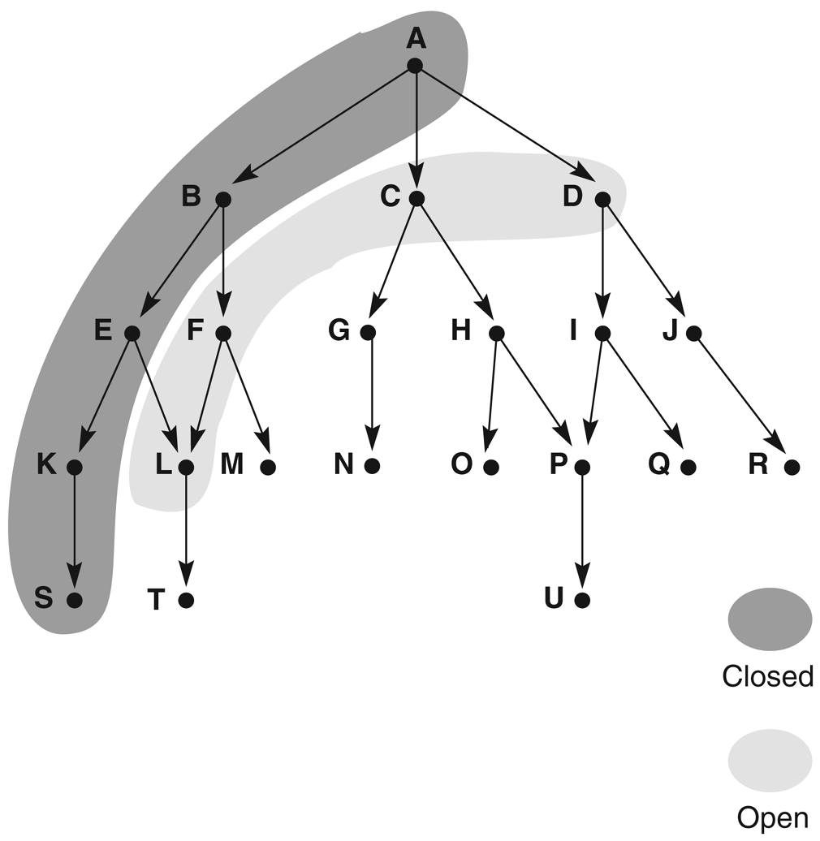
Depth-first search
CS461 Artificial Intelligence © Pinar Duygulu
Spring 2008
Notes:
Therefore unlike breadth first search, the nodes at level d are expanded only after all the other successors of their previous siblings are finished to be expanded
Since the expanded node was the deepest its successor will be even deeper and thus now be the deepest
The tree is searched from left to right

Slide 9
Depth-first search
Expand deepest unexpanded node
Implementation: frontier is a LIFO queue
Notes:
We can implement depth first search as a Last In First Out queue
That is we put the newly generated states in front of the queue

Slide 10
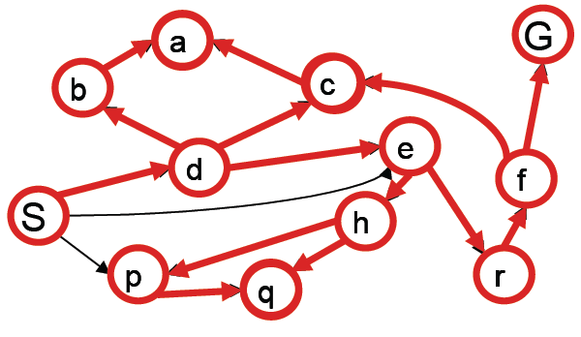
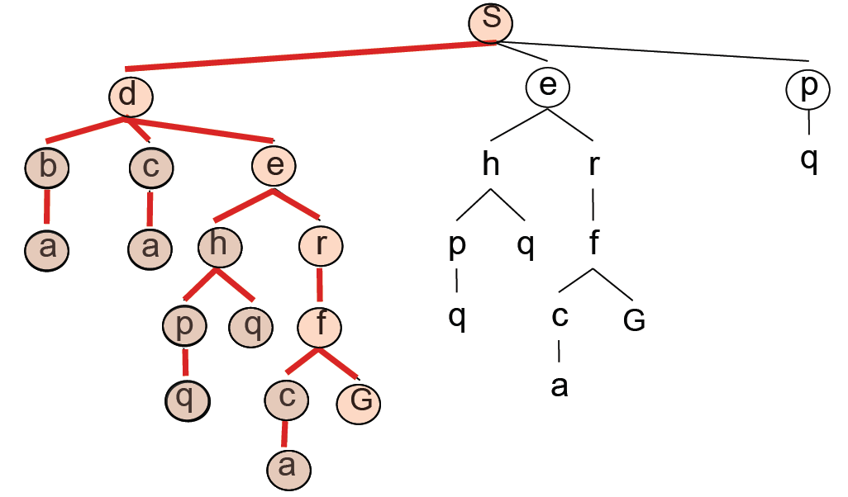
Depth-first search
Expansion order:
(S,d,b,a,c,a,e,h,p,q,q, r,f,c,a,G)
Notes:
If we return back to our example
D’s successors b c and e will be expanded before its siblings e and p
Since b and c will reach to a which is a dead end the search will continue with the nodes that can be accessed from e
Note that now the goal state is reached at 5th level. And we were not able to expand the G at the fourth level with a shorter path cost.
On the other hand, now the number of expanded nodes is 16

Slide 11
Analysis of Search strategies
Strategies are evaluated along the following dimensions:
  completeness: does it always find a solution if one exists?
  time complexity: number of nodes generated
  space complexity: maximum number of nodes in memory
  optimality: does it always find a least-cost solution?
Time and space complexity are measured in terms of
  b: maximum branching factor of the search tree
  d: depth of the least-cost solution
  m: maximum depth of the state space (may be ∞)
CS461 Artificial Intelligence © Pinar Duygulu
Spring 2008
Notes:
Before discussing about other search strategies we will describe four criteria to evaluate the strategies
Completeness : it means whether the strategy can always find the solution if there is any
Optimality : it means whether the strategy can find the least cost solution
Time complexity : it is measured by the number of nodes generated
Space complexity : it is measured by the maximum number of nodes in the memory
For measuring time and space we will need
The maximum branching factor of the search tree, which will be denoted as b
The depth of the least cost solution which will be denoted as d
And the maximum depth of the state space, which will be denoted as m
Note that m may be infinite

Slide 12
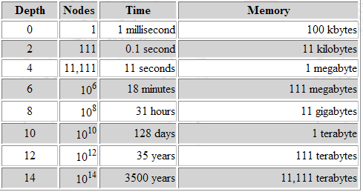
Properties of breadth-first search
Complete? Yes (if b is finite)
Time?
  Number of nodes in a b-ary tree of depth d:
  (d is the depth of the optimal solution)
1+b+b²+b³+… +b^{d} = O(b^{d})
Space? O(b^{d}) (keeps every node in memory)
Optimal? Yes (if cost = 1 per step)
Space is the bigger problem (more than time)
CS461 Artificial Intelligence © Pinar Duygulu
Spring 2008
Notes:
Let’s look at breadth first search
Is it complete?
Yes,
Because if there is a solution it guarantees to find it
And if there are several solutions the breadth first search will always find the shallowest goal state.
However, there is a condition that has to be satisfied here
It is optimal provided that the path cost is a non-decreasing function of the depth of the node.
In the examples that we have seen the path cost was always 1 per step. It means that going from one node to another is 1.
Therefore. the goal state is reached with the path cost being equal to the depth of the goal state.
Since we always expand the nodes at level d before the ones at level d+1. always the goal state with the least cost, that is the goal state in shallower levels, will be expanded first
It is complete and optimal, however it is not a very good strategy when we look at the time and space complexity
Assume that every state can be expanded to yield b new states
The root generates b new nodes, and each of them generates b, resulting in b^2 nodes at the second level.
Assume that we find the goal state at level d
The number of nodes expanded before finding a solution is
1+b+b^2+b^3+ ….. + b^d
This is the maximum number
The solution can be found at any point on the dth level
Consider an example with branching factor b=10
Assuming that 1000 nodes can be checked per second, and a node requires 100 bytes
In this case. We have the numbers shown on the table
As you see the memory requirements are a bigger problem for breadth first than the execution time.
Even if the computers are faster today it means that you have to wait not 35 years for depth 12 but 128 days which is still very large
And for depth 14 it will be still 35 years

Slide 13
Properties of depth-first search
Complete? No: fails in infinite-depth spaces, spaces with loops
  Modify to avoid repeated states along path
    → complete in finite spaces
Time?
  Could be the time to reach a solution at maximum depth m: O(b^{m})
  Terrible if m is much larger than d
  But if there are lots of solutions, may be much faster than BFS
Space? O(bm), i.e., linear space!
Optimal? No - – returns the first solution it finds
CS461 Artificial Intelligence © Pinar Duygulu
Spring 2008
Notes:
The depth first search needs to store only a single path from the root to a leaf node, along with the remaining unexpanded siblings for each node on the path.
If the maximum depth is m the storage required for depth first search is therefore only bm in contrast to b^d of breadth first search
The time complexity is b^m
When there are multiple solutions the depth first search is likely to find it earlier than breadth first search by exploring smaller portion of the whole space.
On the other hand depth first search has a drawback.
It can get stuck on the wrong path.
When there are very deep or even infinite paths we may not be able to explore the other paths.
The search tree will always go downward without a chance to backup
It may not be able to return a solution, or the solution found may be deeper than the optimal solution.
Therefore it is neither complete nor optimal

